Slide 1
WEEK 2
Introduction to HTML

Slide 2
Hypertext and hyperdocuments
The Markup concept
Evolution of HTML
Standards and validation
XHTML and XML
HTML5

Slide 3
Hypertext and hyperdocuments
  The World Wide Web is based on the principle of hypertext
    first defined by Ted Nelson in 1964
    but the concept was suggested by Vannevar Bush in 1945 (“As We May Think”)
    based on linking of documents by associating a part of one document (such as a piece of text) with another document; this is a hyperlink, and any document used in this way is hypertext
  Connecting documents in this way produces a set of hyperdocuments

Slide 4
Hypertext and hyperdocuments
  The Web is the result of combining this concept with
    mechanisms for identifying documents (URLs) and servers (DNS)
    protocols for delivering them (HTTP)
    a markup language for indicating the links (HTML)

Slide 5
Markup principles
  A document is made up of some combination of structural elements
    paragraphs
    headings
    tables
    images
  A markup language is any formal system for indicating document structure within the document

Slide 6
Markup principles
  The process of ‘markup’ involves adding “markers” [tags] to indicate the various structural elements: where a paragraph break occurs, or where text ‘structures’ (such as a change text weight) start and finish
  Markers (tags) may be singular (e.g. meta, images) or in pairs (containers)
  Tags may have attributes defining characteristics of the structure being marked (alignment, size …)

Slide 7
Markup principles
  The ‘grammar’ of specific markup languages are defined in a document type definition (DTD)
  A DTD defines the syntax of all allowable tags and attributes, and a ‘grammar’ for their sequencing and nesting

Slide 8
HTML
  Hypertext Markup Language
  Originally a very simple language, text-oriented system
  Both content and markup are in text (ASCII or Unicode)
  Each ‘version’ of HTML is the result of adopting a specific DTD [1.0, 2.0, 3.0, 3.2, 4.01, 5]
  This is called “standard HTML”

Slide 9
HTML
  Separates web material into
    data
      the actual contents of a document – text, images - that appear to the viewer
      defined by the developer (‘author’) of the content
    structure
      headings, paragraphs, lists identified by tags
      restricted to the tags specified in the chosen DTD
    format
      final appearance ‘on screen’ when the browser has rendered the content and structure
      defined for the browser developer in the DTD (and by exemplar browsers).

Slide 10
‘Standard’ HTML
  If we stick to standard HTML we can be assured that our material will be displayed properly now and in the future
  If we use non-standard HTML we are basically hoping that the browser will ‘correct’ our errors
  The process of checking that we are employing only standard HTML (a specific version) is called validation

Slide 11
“Validation is a process of checking your documents against a formal Standard, such as those published by the Worldwide Web Consortium (W3C) for HTML and XML-derived Web document types … It serves a similar purpose to spellchecking and proofreading for grammar and syntax, but is much more precise and reliable than any of those processes…”
(“The Site Valet”, http://valet.htmlhelp.com/page/why.html)

Slide 12
‘Standard’ HTML
  We can achieve standard HTML in several ways:
    know all the ‘correct’ tags and attributes in a specific version of HTML, and use only those
    use an HTML editor with a built-in validator
    use an online validation service (the W3C validator is the best-known)

Slide 13
XML and XHTML
  XML (eXtensible Markup Language) is the basis for a new approach to markup which allows developers to define their own DTD (hence ‘extensible’)
  XHTML (eXtensible Hypertext Markup Language) is a markup system derived using XML
  As XHTML 1.0 is essentially identical to ‘standard’ HTML 4, any valid HTML document (version 3.1 or 4.1) is also in principle a valid XHTML 1.0 document

Slide 14
XHTML rules enforced
  Must have a doctype and conform to its rules
  Must have <html>,<head> and <body>
  <title> comes first in <head>
  Quote all attributes, <p align=“left”>
  Nest tags properly
  can’t omit optional close tags, </p>
  Empty tags must close, <br /> <hr />
  Lowercase all tags and attribute names

Slide 15
XML and XHTML
  Outside the Web, XML is a significant development as it allows the structure, formatting and ‘handling’ of many forms of data to be defined and communicated
  It offers a completely new and flexible approach to data storage, retrieval and interchange problems (including incorporating data into web documents)

Slide 16
HTML5
  History
  New HTML5 elements
    New semantic elements like <header>, <footer>, <article>, and <section>.
    New form control attributes like number, date, time, calendar, and range.
    New graphic elements: <svg> and <canvas>.
    New multimedia elements: <audio> and <video>.
HTML5 First Public Draft | 2008
HTML5 Living Standard | 2012
HTML5 W3C Final Recommendation | 2014

Slide 17
HTML
HyperText Markup Language
Describes the structure of the content of a document, not its appearance
The web browser formats the HTML i.e. it interprets the HTML and displays an image on the screen

Slide 18
WRITING HTML
Tags
  instructions embedded in text
  enclosed in brackets < >
  start tags
  closing tags preceded by /

Slide 19

WRITING HTML
Use a text editor such as NotePad
  uses plain text
  Word processing programs save as Text Only
Save file with a file extension
  .html
  .htm
  use simple file names
  do not include spaces in file names

Slide 20
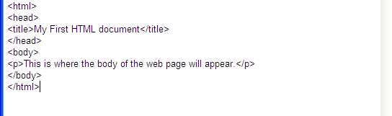
A SIMPLE HTML DOCUMENT

Slide 21
DOCTYPE
DOCUMENT TYPE DEFINITION (DTD)
Identifies the type of HTML used by the page.
Like a “dialect”
Allows validation software to determine that the document is syntactically correct.
HTML5 - <!DOCTYPE html>
XHTML1.0 -
<!DOCTYPE html PUBLIC “-//W3C//DTD XHTML 1.0 Strict//EN”
http://www.w3c.org/TR/xhtml1/DTD/strict.dtd>

Slide 22
<HTML>
The first page structure tag in every HTML page.
It indicates that the file is written in the HTML language.
All text and HTML commands should go within the beginning and end HTML tags
  <html>
  your page
  </html>

Slide 23
<HEAD>
Information about the document.
  meta information
    meta information is used by search engines to index pages
  author contact information, scripts, stylesheets and comments
Not displayed in the document.

Slide 24
<TITLE>
Included in the <head> tag
Indicates what your page is about.
Appear in the title bar of a browser.
Used as bookmark title and search engines.
<html>
<head>
<title>My First HTML Page</title>
</head>
...

Slide 25
<BODY>
The rest of the page is included within the <body> tags.
<html>
<head>
<title>My First HTML Page</title>
</head>
<body>
The rest of the page.
</body>
</html>

Slide 26
HEADINGS
Used to divide sections of text just like in a book or report.
There are six levels.
  <h1>A main heading</h1>
  <h2></h2>
  …
  <h6></h6>

Slide 27
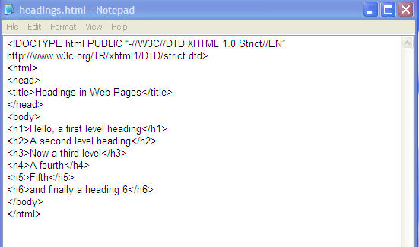

Slide 28
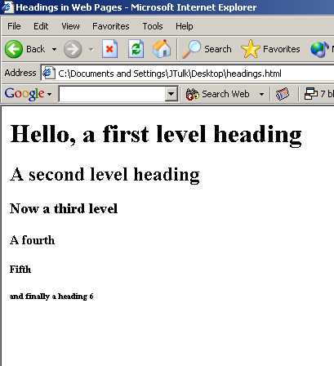

Slide 29
PARAGRAPHS
Adds space around text
  <p>
  </p> end tag is optional but required for XHTML

Slide 30
LISTS
Numbered (ordered)
Bulleted (unordered)
Glossary lists

Slide 31
NUMBERED (ORDERED) LISTS
<p>My shopping list:
<ol>
<li>Cheese</li>
<li>Rice</li>
<li>Olive oil</li>
</ol>
My shopping list:
  1. Cheese
  2. Rice
  3. Olive oil
<ol> </ol> two sided tags
<li> list items have optional closing tags

Slide 32
TYPE ATTRIBUTE
An attribute contains options about the tag and should be in quotes.
<ol type=“a”>
“1” Arabic numerals
“a” lowercase letters
“A” uppercase letters
“i” lowercase Roman
“I” uppercase Roman
My shopping list:
  a. Cheese
  b. Rice
  c. Olive oil

Slide 33
START ATTRIBUTE
An attribute contains options about the tag.
<ol start=“4”>
My vegetable list:
  4. Carrots
  5. Tomatoes
  6. Lettuce

Slide 34
BULLETED (UNORDERED) LISTS
<p>My shopping list:
<ul>
<li>Cheese </li>
<li>Rice </li>
<li>Olive oil </li>
</ul>
My shopping list:
  Cheese
  Rice
  Olive oil
Remember: the </li> is still optional in HTML but should be used to conform with XHTML.

Slide 35
TYPE ATTRIBUTE
An attribute contains options about the tag.
<ul type=“square”>
“circle”
“disc”
“square”
My shopping list:
  Cheese
  Rice
  Olive oil

Slide 36
GLOSSARY LISTS
<DL>
Two parts
  the term <dt>
  its definition <dd>
<dl> is a two sided tag </dl>
</dt> and </dd> are optional closing tags in HTML

Slide 37
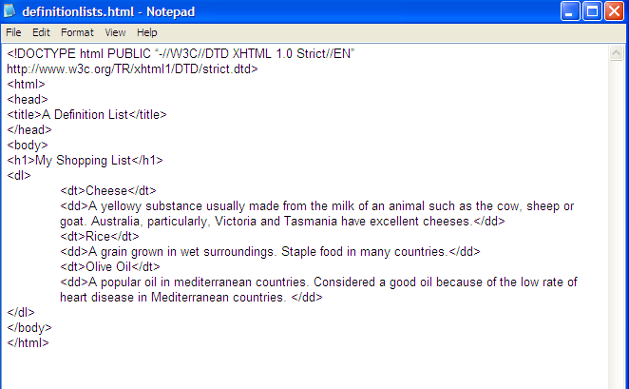

Slide 38
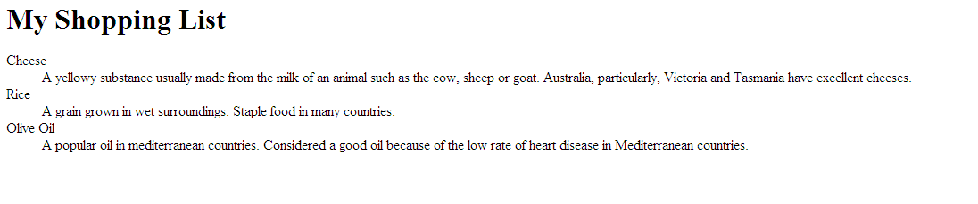

Slide 39
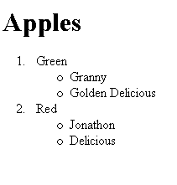
NESTED LISTS
<h1>Apples</h1>
<ol>
<li>Green
<ul>
<li>Granny</li>
<li>Golden Delicious</li>
</ul>
</li>
<li>Red
<ul>
<li>Jonathon</li>
<li>Delicious</li>
</ul>
</li>
</ol>

Slide 40
COMMENTS
<!-- This is a comment and it will not appear on the web page unless the page source is viewed. -->

Slide 41

LINKS

Slide 42
<A> … </A>
Anchor - creates a link from the current page to another part of the page, a new page, a different web site, an email address.
My shopping list:
<a href=“cheeses.html”>cheeses</a>
My shopping list: cheeses

Slide 43
LINKING TO REMOTE FILES
My shopping list:
<a href=“http://www.kraft.com.au”>cheeses</a>
My shopping list: cheeses

Slide 44
Cheeses
<a name=“toppage”><h1>Cheeses</h1></a>
This is a very long web page with sub headings. At the end of each paragraph I will have a link to the top of the page. xxxxxxxxxxxxxxxxxxxxxxx
xxxxxxxxxxxxxxxxxxxxxxxxxxxxxxxxxxxxxxxxxxxxxxxxxxxxxxxxxxxxxxxxxxxxxxxxxxxxxxxxxxxxxxxxxx
xxxxxxxxxxxxxxxxxxxxxxxxxxxxxxxxxxxxxxxxxxxxxxxxxxxxxxxxxxxxxxxxxxxxxx
Top of page
<a href=“#toppage”>Top of page</a>

Slide 45
MAILTO:
Send mail to
<a href=“mailto:atuls@deakin.edu.au”>Atul</a>
Send mail to Atul

